Slide 1
Chicago Crime Analysis
Win

Slide 2
Abstract
The “Crime 2001 to present” dataset from Chicago Public Portal is used for this research.
https://data.cityofchicago.org/Public-Safety/Crimes-2001-to-present/ijzp-q8t2
The following research questions are analyzed and presented.
the percentage of change over the years of different crime types in Chicago (2001-2019)
which locations are more susceptible to violent crimes (2001-2019)
neighborhoods with the most violent crimes in 2019
Bar plots and heatmap are used to present the percentage change of violent and property crime types in Chicago over the years from 2001 to 2019. Pie charts are used to show how proportions of certain locations are more susceptible to different types of violent crimes. Spatial data is presented in Maps of Chicago with the overlay of its neighborhoods and crime heatmap. kMeans clustering is used to identify the Chicago neighborhoods where most of the violent crimes occur. Different data cleaning techniques have been used throughout to minimize the effects of the limitations on the analysis.
Based on the analysis on the % change over the years, it is found that overall the crimes have declined over the time in Chicago neighborhoods. Special patterns are found of the locations where the crimes took place in relation to the nature of the crimes. The association between the crime types and the specific localities in a city gave the quality insight into crime-prone areas within a city where ‘West side’ of the Chicago especially neighborhood named “Austin” has the highest violent crime rate for 2019. From the kMeans clustering, it is found that the violent crime occurs in a small number of concentrated areas a.k.a crime hot-spots.

Slide 3
Motivation
With the technology advancement over the years, crime data analytics is becoming a new weapon against the crime. Chicago is one of the most dangerous cities in the America in 2019 [Ref:1](cbsnews.com). According to [Ref:2], the rate of violent crimes in Chicago has decreased in 2019. Is the claim really supported by the data? While there is a crime rate reduction in the city overall, there are certain neighborhoods, especially in less-advantaged neighborhoods, where violent crimes are heavily concentrated. Divergence of segregated neighborhoods in crime occurrences are persistent across the time.
Crime analysis helps to uncover the patterns and trends of crime occurrences. Analyzing and understanding of crime-specific occurrence rates and the corresponding criminal location, neighborhoods indicates that different neighborhoods are exploited for different kinds of crime. Prediction of high probability of crime rate and distinguish areas which have a higher crime rate can help the law enforcement by enforcing preventive measures such as assigning more polices in the crime-prone areas.
As such, "Chicago Crime Analysis" will be my research topic for the final project.

Slide 4
Dataset(s)
Crime data from 2001 to present
https://data.cityofchicago.org/Public-Safety/Crimes-2001-to-present/ijzp-q8t2
Additionally Chicago neighborhood geojson is downloaded from https://data.cityofchicago.org/Facilities-Geographic-Boundaries/Boundaries-Neighborhoods/bbvz-uum9
Note: Dataset of “Crime data from 2001 to present” is up-to-date and I have downloaded the dataset on 11/03/2019. The dataset for 2019 has data for crimes occurred in October 2019. As there are only 2 months left to the year end of 2019, the dataset is used in analysis including of Year 2019.

Slide 5
Data Preparation and Cleaning
First data preparation is categorizing the crime types into two: violent crimes, property crimes, based on FBI’s index crime categories[Ref:4].
Second step is geocoding as there are many rows without valid latitude, longitude values. Based on the information from ‘Block’ column where there are approximate addresses (Street names) are extracted. The addresses, combination of street names and city(Chicago), State (Illinois) are then geocoded to get the latitude, longitude values.
The last step is assigning the neighborhood to each crime. Based on the “Chicago Boundaries - Neighborhoods geojson” data, if the latitude and longitude (Point) is inside the multi-polygon(boundaries) of the neighborhood, the neighborhood is assigned for each row of the dataset.

Slide 6
Data Preparation and Cleaning
Categorizing the crime types took some time as the “Primary Type” alone cannot be used to categorize cleanly. Both “Primary Type” and “Description” columns are used to categorize into violent and property crimes: Violent Crimes: Crimes Against the Person , Property Crimes: Crimes Against Property.
I struggle some time to get the geocoding working properly. I do not want to use the manual method of getting the geocode data whereby uploading the excel files for translation. As I prefer to geocode it programmatically, it took time to get the good geocoder library. I made the mistake at first as without cleaning the data, the function ended up calling geocoder many times. As a result, I got the “Too many requests” Http 429 error from the Server. Eventually I cleaned up the data so that only a smaller set of rows, where latitude and longitude are null, and removal of duplicates, were used to ask for geocode service. Another struggle is getting the correct neighborhoods based on latitudes, longitudes as original dataset does not have neighborhood column.
As I want to display the crime data in the Maps, it took me some time setting up the google API key and getting the proper maps with overlay layers using geojson.

Slide 7
Research Question(s)
the percentage of change over the years (2001-2019) of different crime types
which locations are more susceptible to violent crimes (2001-2019)
Neighborhoods with the most violent crimes in 2019

Slide 8
Methods
Bar plots and heatmaps are used for the analysis of comparison over the years. The linear nature of bar plots make it easier for precise comparisons.
I find that the color scale of heatmap as a very useful feature to see the trend of crime statistics over the years. I used 2 color tones (Red and Green) to indicate the increase or decrease of crimes. The color intensity is then correlated with the ascending order of the numbers.
kMeans clustering is used to categorize the neighborhoods and ‘sides’ of the Chicago into k groups. It is used to partition ‘n’ observations into ‘k’ clusters in which each observation is assigned to the cluster with the nearest mean.

Slide 9
Findings
Research Question 1:
the percentage of change over the years of different crime types in Chicago (2001-2019)
Crime types are categorized into violent and property crime types.
Dataset from 2001 to 2019 are used.
Research Question 1

Slide 10
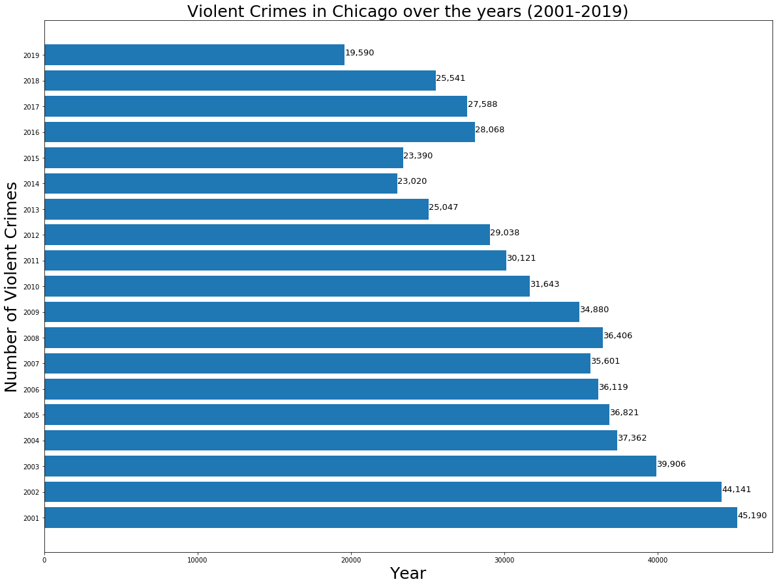
Findings
Violent crimes rate decreasing over the years
Research Question 1

Slide 11
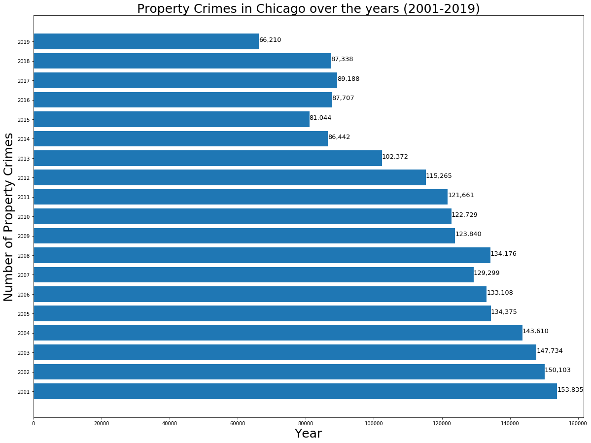
Findings
Property crimes rate decreasing over the years
Research Question 1

Slide 12
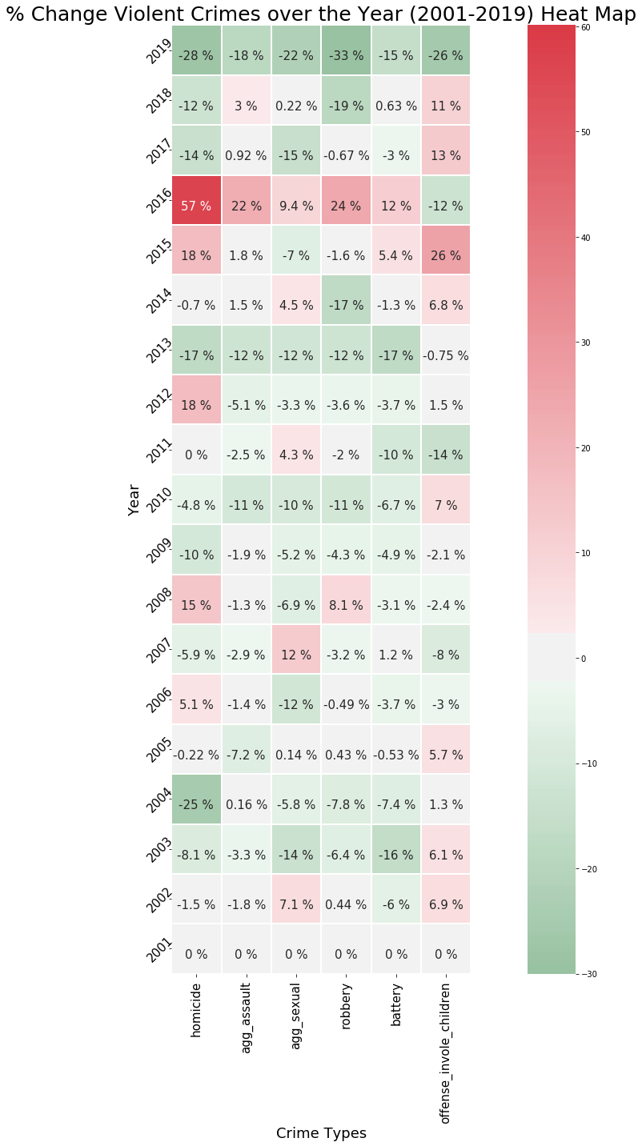
Findings
% change of crimes comparing the current year from the previous year.
E.g. % in 2016 means compare 2016 data against 2015 data
2016 data cells are mostly “RED”
Mostly positive values especially in ‘Homicides’.
This data is consistent with [Ref:3] article from ‘Times’ that “Chicago experienced its deadliest year in almost two decades in 2016.”
Positive % indicates
"Red" = undesirable trend. i.e. increase crimes
Negative % indicates "Green" = desirable trend.
i.e. decrease crimes
Research Question 1

Slide 13
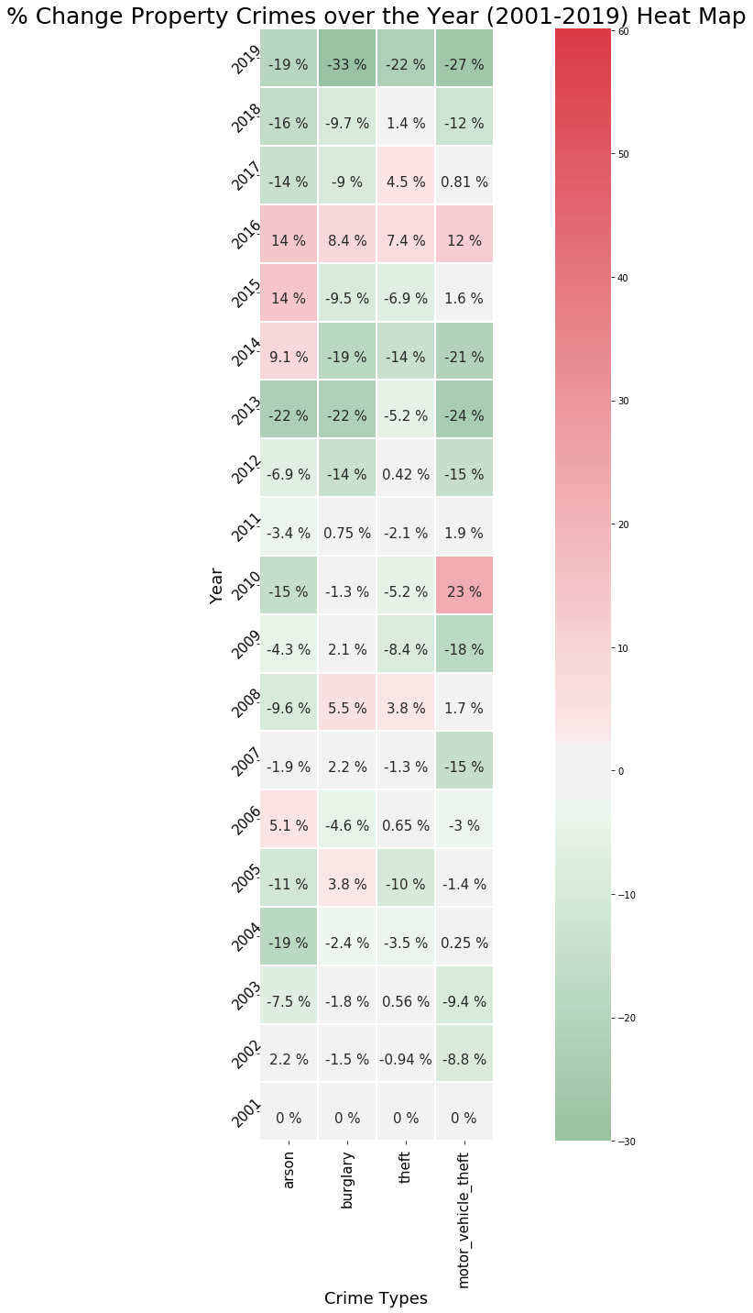
Findings
% change of crimes comparing the current year from the previous year.
E.g. % in 2016 means compare 2016 data against 2015 data
2016 data cells are mostly “RED”
Positive % indicates
"Red" = undesirable trend. i.e. increase crimes
Negative % indicates "Green" = desirable trend.
i.e. decrease crimes
Research Question 1

Slide 14
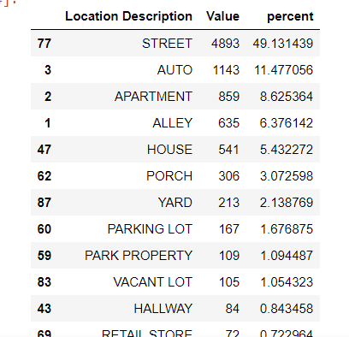
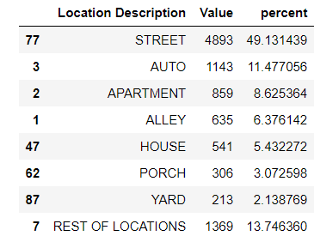
Findings
Research Question 2:
which locations are more susceptible to violent crimes (2001-2019)
Calculate the percentage of homicide crime happening in the certain location comparing to others.
If the percent is less than 2%, all will be put into "rest of the locations".
For example, in homicide location data, for the location where occurrence is less than <2 % are put into “Rest of the location”
Research Question 2

Slide 15
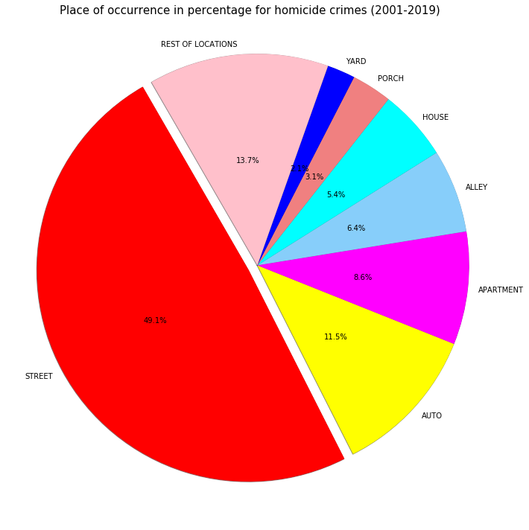
Findings
Homicides mostly occurred in ’STREET’
Research Question 2

Slide 16
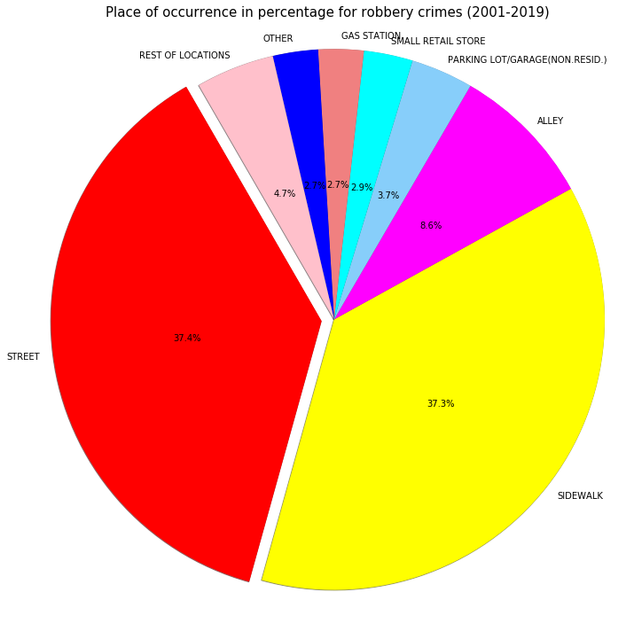
Findings
Robberies mostly occurred in ’STREET’
or ‘SIDEWALK’
Research Question 2

Slide 17
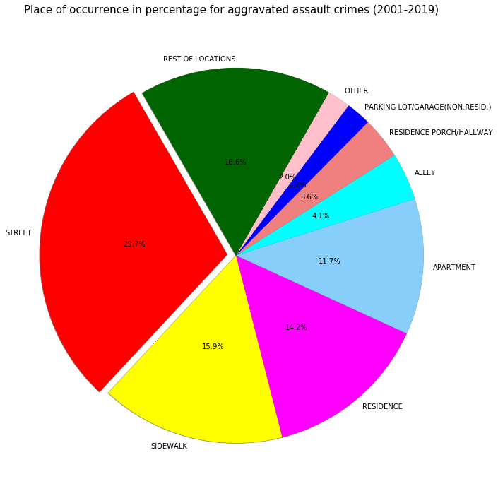
Findings
Aggravated assaults occurrence is more distributed in various locations though occurrence in ‘STREET’ is still higher than the rest.
Research Question 2

Slide 18
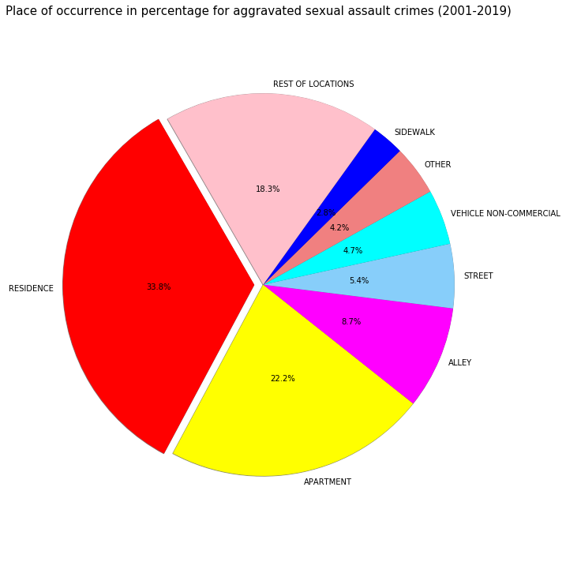
Findings
Aggravated sexual assaults occurred mostly in ‘RESIDENCE’ or ‘APARTMENT’
Research Question 2

Slide 19
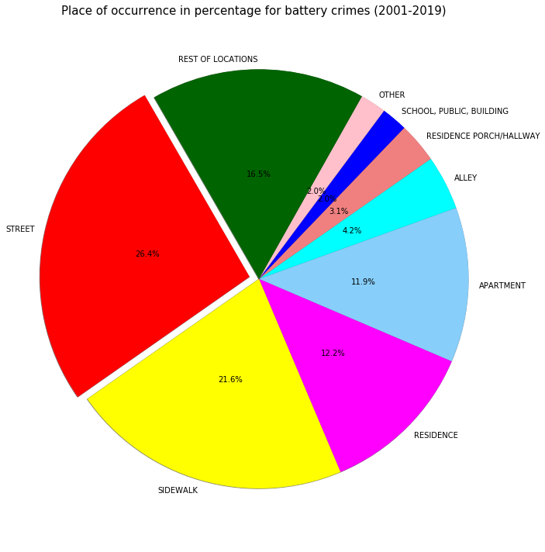
Findings
Battery crime occurrence is more distributed in various locations though occurrence in ‘STREET’ is still higher than the rest.
Research Question 2

Slide 20
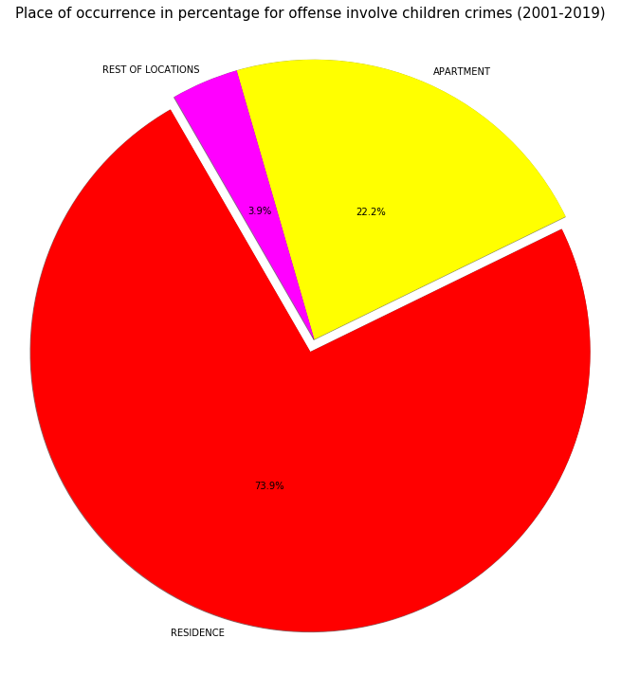
Findings
Offense that involve children mostly occurred in
‘RESIDENCE’
Research Question 2

Slide 21
Findings
Research Question 3:
Neighborhoods with the most violent crimes in 2019
- Chicago neighborhood and sides for each crime are assigned based on https://en.wikipedia.org/wiki/Community_areas_in_Chicago
Research Question 3

Slide 22
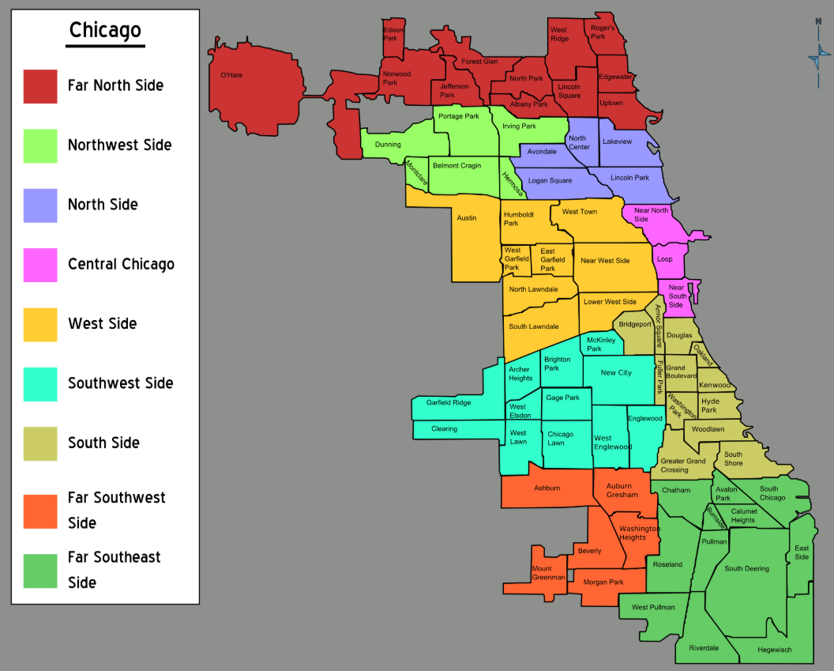
Findings
Chicago Neighborhoods and sides
Research Question 3
Ref:
https://upload.wikimedia.org/wikipedia/commons/b/b3/Chicago_neighborhoods_map.png

Slide 23
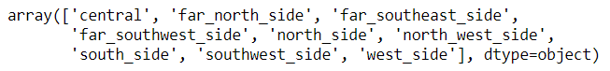
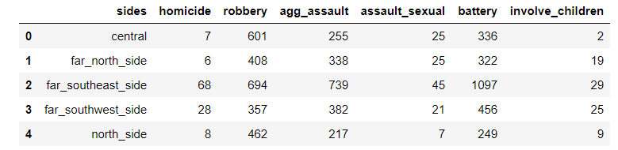
Findings
Based on information from https://en.wikipedia.org/wiki/Community_areas_in_Chicago
There are 77 unofficial Chicago community areas (Neighborhoods) with 9 ‘sides’ as follow.
Then each violent crime types are assigned with corresponding sides.
The aim is to find the crime-prone side within a city.
Samples of 5 rows
Research Question 3

Slide 24
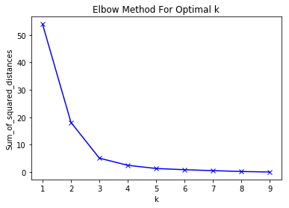
Findings
kMeans clustering is used in dividing the data points into a number of groups such that data points in the same groups are closer to other data points in the same group than those in other groups. Different crime types of violent crimes are assigned to each Chicago side and then using kMeans clustering to segregate groups based on similarity and assign them into clusters.
Elbow method is used to find optimal k values.
K= 3 is used for clustering.
Clusters=3
Research Question 3

Slide 25
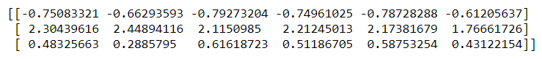
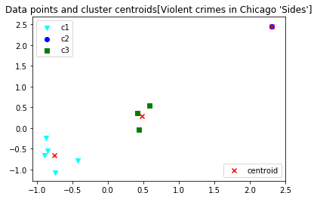
Findings
Below is the result of cluster means. Here negative values mean “lower than most”
and positive values mean “higher than most”.
Cluster c2
We can see the clustering is quite clean without noise so selection of k=3 is good. Based on the result, cluster c2 has the positive values meaning that it has higher crimes than cluster c1 and cluster c3. There is only one point in the cluster c2 (on top right corner) while the most data points are the lower left corner cluster c1. This means that the c2 has high concentration whereas c1 and c3 have more data points, it is likely that more Chicago sides fall into cluster c1 or c3.
c2
With k=3
Research Question 3

Slide 26
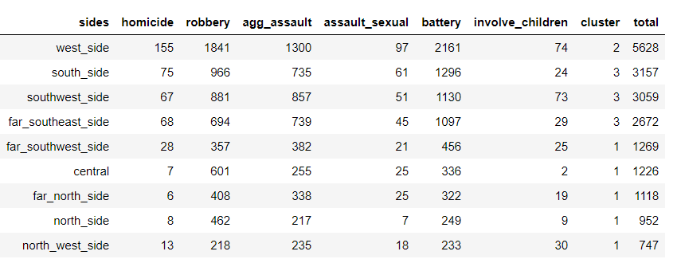
Findings
Each row are assigned with corresponding cluster and then calculated the total number of violent crimes occurred.
From here, we can conclude that Cluster c2 “West Side” is the Chicago side that is most susceptible to the violent crimes.
Cluster c2
Research Question 3

Slide 27
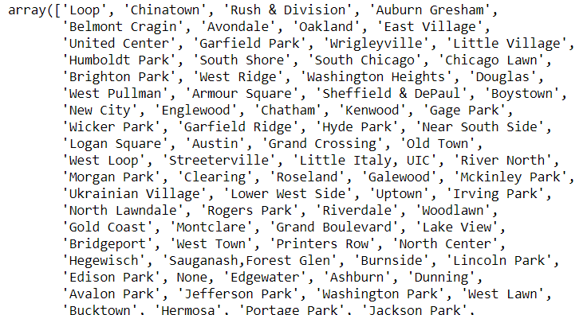
Findings
From the previous kMeans analysis, we found that the cluster-2 which is the west side of Chicago has the highest violent crimes than the rest.
Now the similar kMeans clustering is used to get the Neighborhoods where the most violent crimes occur.
Here are some of the neighborhoods of Chicago.
Research Question 3

Slide 28
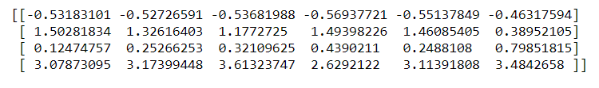
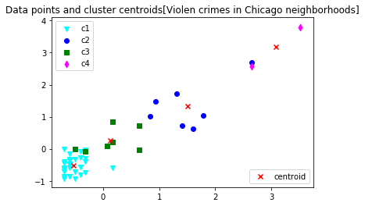
Findings
Cluster c4
With k=4
Research Question 3

Slide 29
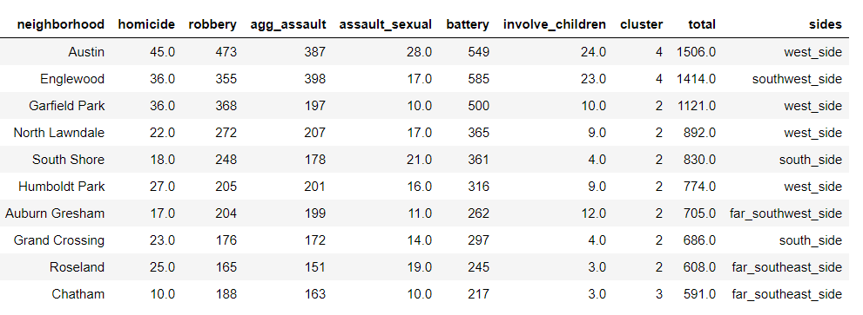
Findings
Each row are assigned with corresponding cluster and then calculated the total number of violent crimes occurred sorted by descending order. We can see that Cluster 4 which has the highest total violent crimes is the neighborhood “Austin”. The Chicago side is “West Side” which is consistent with the first finding where the Chicago “West Side” has been identified as the most dangerous neighborhood.
C4
Research Question 3

Slide 30
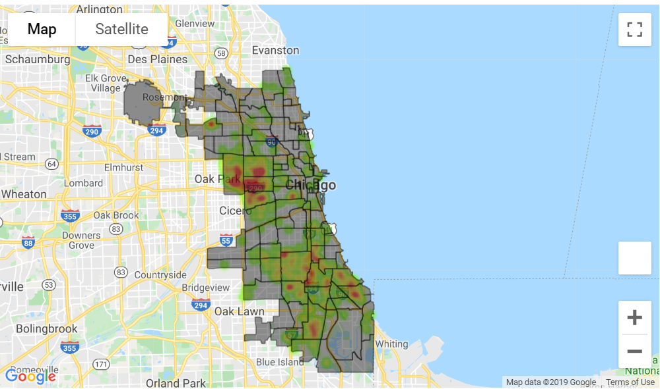
Findings
Heatmap of ‘Homicide’ occurrence in Chicago Neighborhoods (2019)
Most homicide crimes occurred in West side
Research Question 3

Slide 31
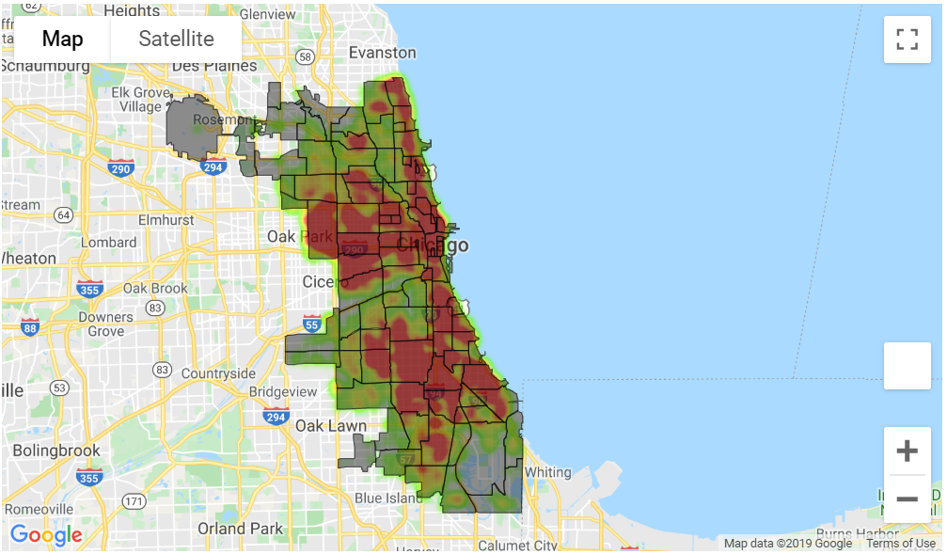
Findings
Heatmap of ‘Robbery’ occurrence in Chicago Neighborhoods (2019)
Robberies are more spread out across neighborhoods with higher occurrences in West side, Central, Southwest side and South side
Research Question 3

Slide 32
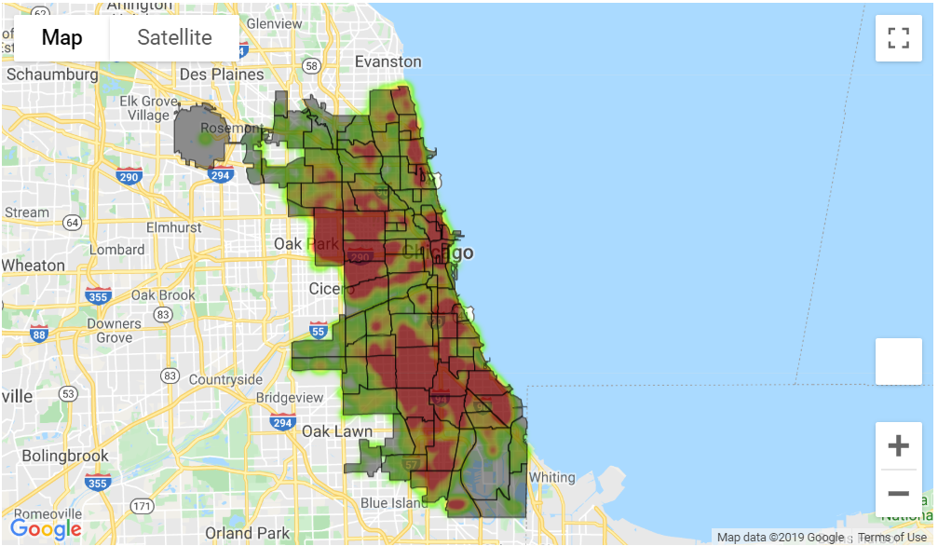
Findings
Heatmap of ‘Aggravated Assaults’ occurrence in Chicago Neighborhoods (2019)
Aggravated assaults are more spread out across neighborhoods with higher occurrences in West side, Southwest side and South side
Research Question 3

Slide 33
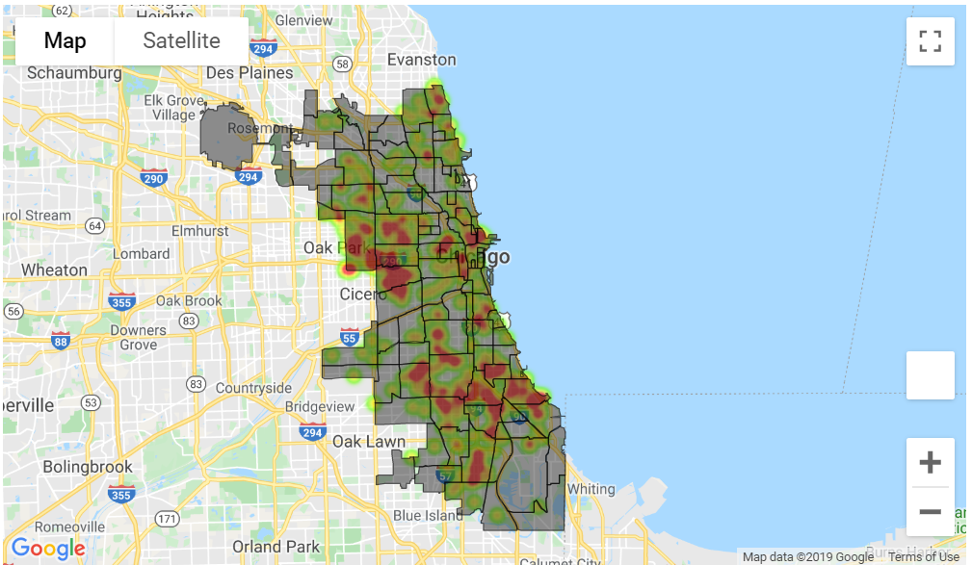
Findings
Heatmap of ‘Sexual Assaults’ occurrence in Chicago Neighborhoods (2019)
Sexual assaults have overall less concentration with some higher occurrences in west and south side
Research Question 3

Slide 34
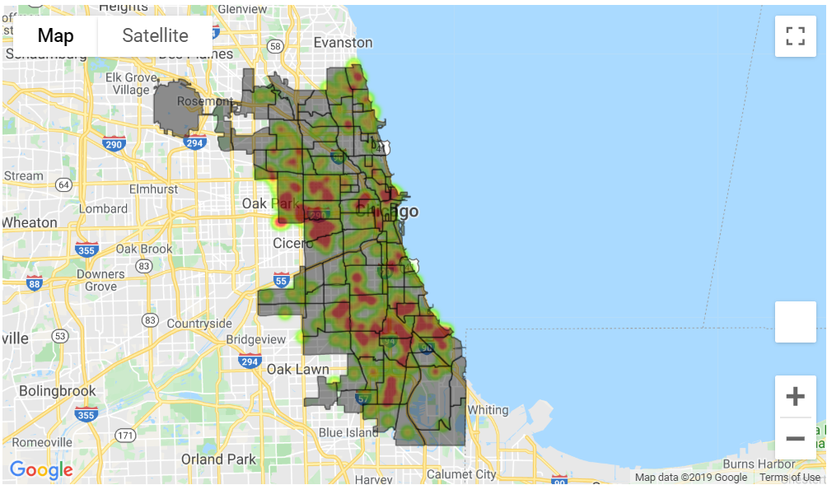
Findings
Heatmap of ‘Battery’ occurrence in Chicago Neighborhoods (2019)
Batteries have overall less concentration with some higher occurrences in west and south side
Research Question 3

Slide 35
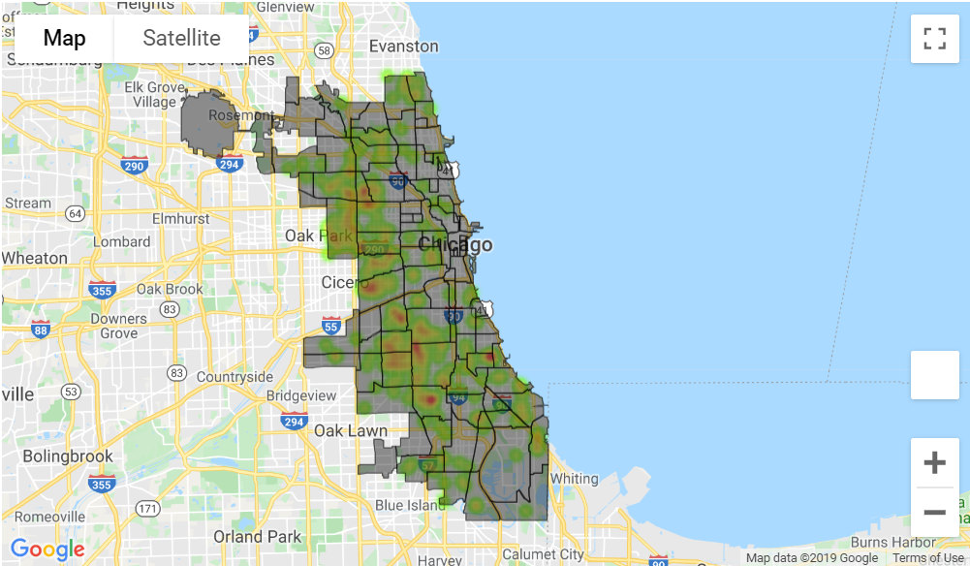
Findings
Heatmap of ‘Offense involve children’ occurrence in Chicago Neighborhoods (2019)
Offenses involving children have overall less concentration
Research Question 3

Slide 36
Limitations
Some of the latitudes , longitudes values are not present in the dataset so instead geocoding is done based on the ‘Block’ approximate address, so if the address is in the boundary between two neighborhoods/Chicago sides, it may be included in one side over the another.
2019 dataset is downloaded on 11/03/2019, as such crimes in the rest of November and December of 2019, approximately one and half month, of data are not included for analysis.

Slide 37
Conclusions
The three research questions have been answered based on the data analysis of the crime dataset from the Chicago police’ crimes from 2001 to present/2019’ dataset.
The percentage of change over the years of different crime types in Chicago from 2001 to 2019 is overall declining. There is a spike of crime rate increment in 2016 which is consistent with “Times” and Chicago Tribunes reporting as most violent month as August, Year as 2016 over two decades.
Which locations are more susceptible to violent crimes? Based on the nature of the crime types, some locations are more susceptible than the other. Streets tend to be common places for murders and robberies. Most of the sexual assaults and offenses involving children occurred in residences. The location and nature of crimes may be related to the opportunist behavior and intentional behavior of the criminals where ‘intentional behavior’ criminals may choose the locations before the crime is committed as most are intentionally targeted.
Neighborhoods with the most violent crimes in 2019 has been identified as “West” side of the Chicago neighborhood called “Austin”.
Further study can be done on whether there are correlations between the hours of the days, the month of the year with the rate and type of crime occurrences. Study of residential stability, poverty rate and unemployment, immigration concentration in the least safe neighborhoods vs the safest neighborhoods, can be another interesting research topics to explore.

Slide 38
Acknowledgements
I have not asked anyone for feedback though I will later send this report to some of my friends who may be interested in data analysis research for their feedback .

Slide 39
References
1. https://www.cbsnews.com/pictures/the-most-dangerous-cities-in-america/12/
2. https://chicago.suntimes.com/news/2019/7/1/20676793/chicago-shootings-four-year-low-through-first-half-of-2019-police-crime-stats
3. https://time.com/4635049/chicago-murder-rate-homicides/
4. Index Crimes http://home.chicagopolice.org/wp-content/uploads/2018/04/Definitions-IndexCrimeCategories.pdf
5. Chicago neighborhood and sides : https://en.wikipedia.org/wiki/Community_areas_in_Chicago https://upload.wikimedia.org/wikipedia/commons/b/b3/Chicago_neighborhoods_map.png
6. https://www.chicagotribune.com/news/breaking/ct-august-most-violent-shootings-chicago-20160829-story.html

